Slide 1

Early Detection of Alzheimer's Disease
INTERNSHIP 2
Faculty Guide
Dr Rakesh Kumar S
Presented By
Kandukuri Bhanu Prakash
Sadda Balaji
Dept of Computer Science & Engineering

Slide 2
INDEX
Abstract
Certificate
Introduction
Objective
Demonstration of AD
Implemented Model
Explanation of Model
Results and Comparision
Conclusion
Dept of Computer Science & Engineering

Slide 3
Abstract
Early detection of Alzheimer’s disease is crucial for improving treatment outcomes and patient quality of life. This study investigates the application of advanced machine learning models to enhance the accuracy of early Alzheimer’s diagnosis using neuroimaging data. We specifically evaluate three deep learning-based convolutional neural networks (CNNs): VGG19, DenseNet, and SqueezeNet. VGG19, known for its deep architecture, offers detailed feature extraction. DenseNet, with its densely connected layers, aims to improve gradient flow and feature reuse. SqueezeNet focuses on achieving high performance with fewer parameters, making it suitable for resource-limited environments.
The study involves training these models on a comprehensive dataset of brain MRI scans and comparing their performance in detecting early signs of Alzheimer’s disease. By assessing the strengths and limitations of each model, our goal is to identify the most effective approach for early diagnosis. The results are expected to provide valuable insights into which model offers the best balance of accuracy and efficiency. Ultimately, this research aims to advance diagnostic tools and contribute to more effective early intervention strategies for Alzheimer’s disease.
Dept of Computer Science & Engineering

Slide 4
Certificate
Paste your internship Certificate
Dept of Computer Science & Engineering

Slide 5
INTRODUCTION
Alzheimer’s disease is a neurodegenerative disorder that primarily affects memory, thinking, and behavior. It is the leading cause of dementia, affecting millions of people worldwide.
AD is the most common form of dementia and is associated with the accumulation of beta-amyloid in brain cells, which leads to the degeneration of cognitive functions.
Impact: affects millions worldwide, leading to significant burden on individuals and families
Early detection is crucial as it allows for timely intervention, which can slow disease progression and improve the quality of life for patients and their families.
Traditional diagnostic methods, such as cognitive tests and imaging techniques, can be invasive and often lack early sensitivity.
Dept of Computer Science & Engineering

Slide 6
OBJECTIVE
Goal:
Develop a highly accurate model using neuroimaging data.
Improve diagnostic accuracy and reduce false positives.
Scope:
Assess each model's performance in terms of accuracy, efficiency, and robustness using neuroimaging data.
Determine which model provides the best diagnostic capabilities and identify areas for improvement.
Dept of Computer Science & Engineering

Slide 7
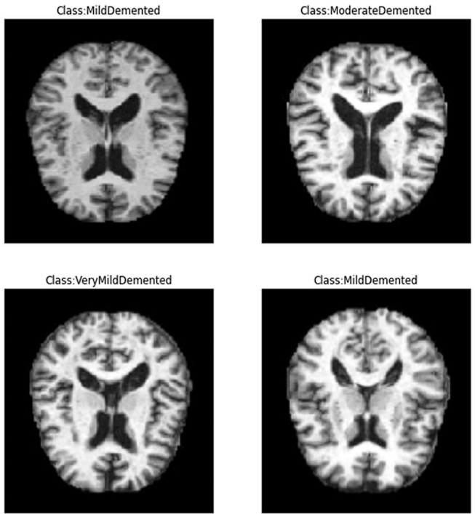
Demonstration Of Alzheimer's Disease
Comparison Between Different classes of infected brain in MRI
Dept of Computer Science & Engineering

Slide 8
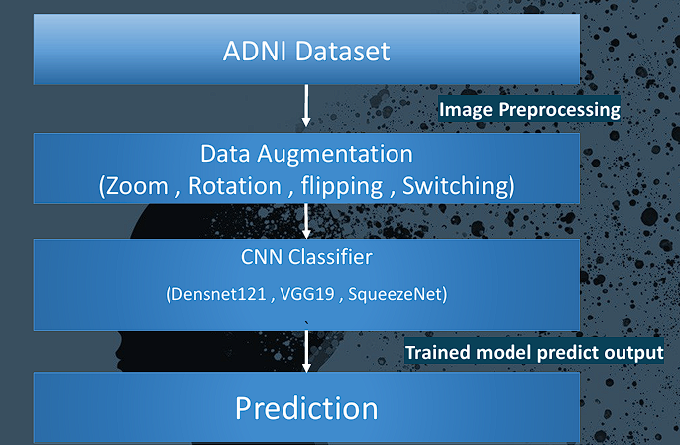
Implemented Model
Dept of Computer Science & Engineering

Slide 9
Data Set
The Data Set Consists of 6400 Images
Category 1: Mild Demented (896 images)
Category 2: Moderate Demented (64 images)
Category 3: Non-Demented (3200 images)
Category 4: Very Mild Demented (2240 images)
Dept of Computer Science & Engineering

Slide 10
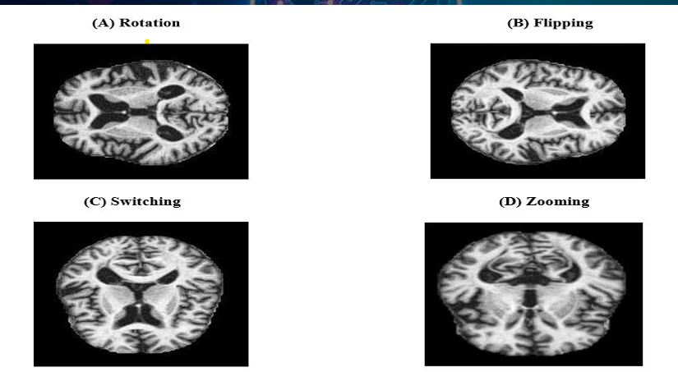
Image Preprocessing
We applied Data Augmentations techniques such as zoom, rotation , flipping and switching.
1. The factor parameter for rotation is between -0.15 ,0.15.
2. The factor parameter for zoom is between -0.3 , -0.1.
Dept of Computer Science & Engineering

Slide 11
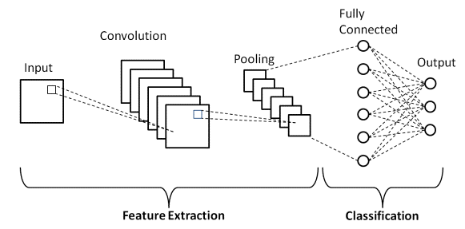
Implemented Model
We utilized three advanced convolutional neural network (CNN) architectures: VGG19, DenseNet121, and SqueezeNet. Additionally, data augmentation techniques such as zoom and rotation were applied to enhance the diversity of training data and improve model generalization. The model was trained and evaluated using the Alzheimer's Disease Neuroimaging Initiative (ADNI) dataset, a publicly available dataset containing clinical, imaging, and genetic data from over 1,500 participants, including those with normal cognition, MCI, and AD.
Dept of Computer Science & Engineering

Slide 12
VGG19 Architecture
VGG19 is a deep convolutional neural network (CNN) architecture characterized by its 19 layers, including 16 convolutional layers and 3 fully connected layers. Renowned for its hierarchical feature extraction capabilities, VGG19 excels in capturing intricate patterns and details from medical images, making it highly effective for tasks such as Alzheimer's Disease detection.
Strengths:
Detailed Feature Extraction: Capable of capturing intricate patterns and details in MRI images, crucial for detecting early and subtle changes in brain structures associated with Alzheimer’s Disease.
Proven Track Record: Widely used in various image analysis tasks, including medical imaging, due to its effectiveness in feature extraction.
Challenges:
Computational Intensity: Requires significant computational resources and memory due to its large number of parameters.
Overfitting Risk: Higher potential for overfitting on small datasets without proper regularization techniques.
Dept of Computer Science & Engineering

Slide 13
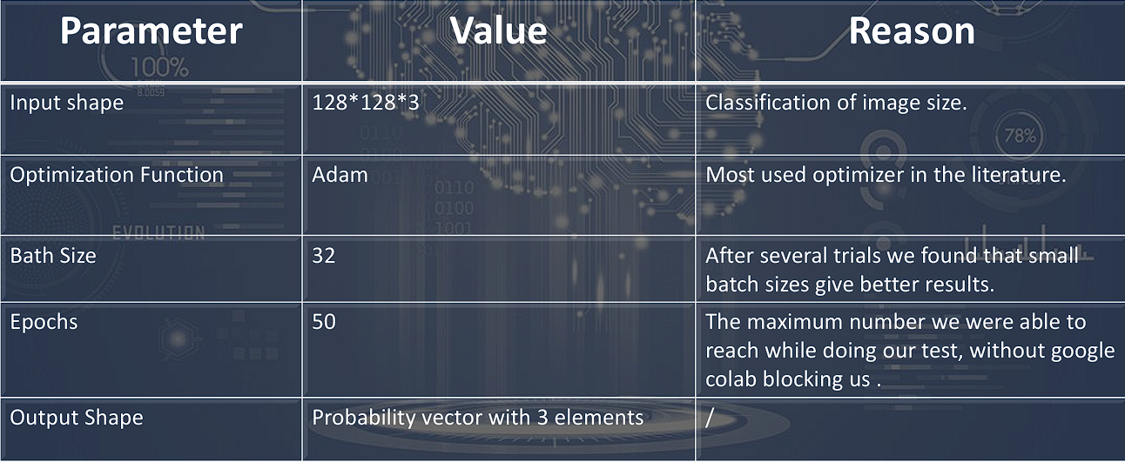
VGG19
Parameter | Value | Reason
Input Shape | 128x128x3 | Classification of image size.
Optimization Function | Adam | Most used optimizer in the literature.
Batch Size | 32 | Small batch sizes gave better results after several trials.
Epochs | 50 | Maximum number achievable during testing without Colab restrictions.
Output Shape | Probability vector with 4 elements | Represents the probability distribution across 4 categories.
Dept of Computer Science & Engineering

Slide 14
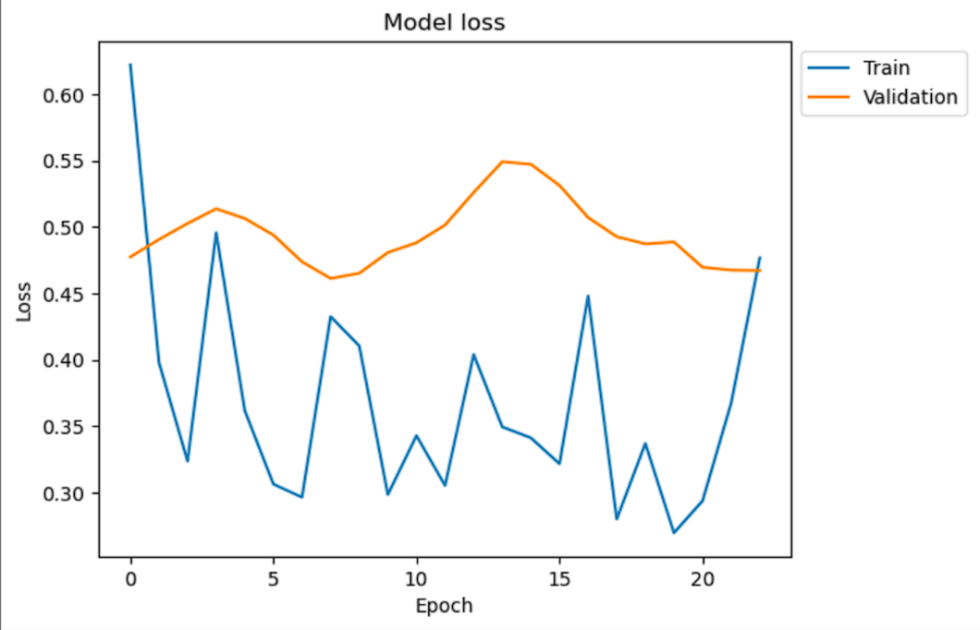
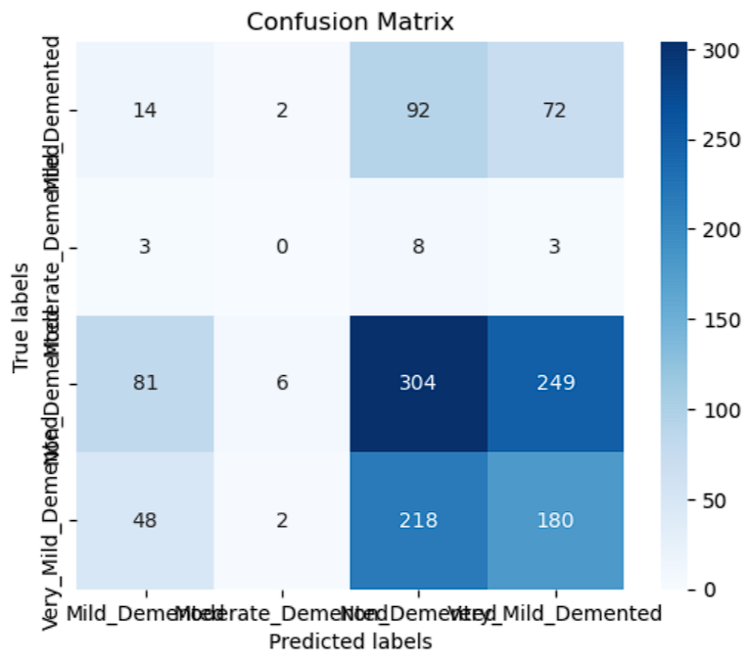
Training and Validation Loss And Confusion Matrix
Dept of Computer Science & Engineering

Slide 15
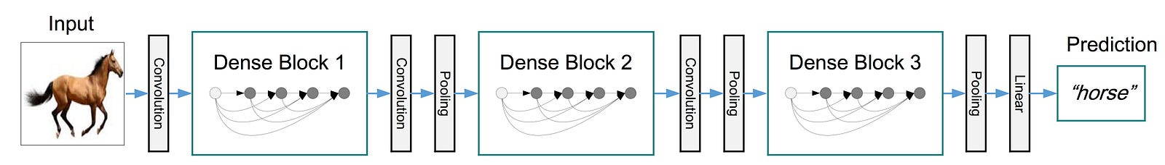
DenseNet
Layers: 121 layers with dense blocks.
Design: Dense connections for feature retention and reuse.
Strengths
Improved Gradient Flow: Mitigates vanishing gradient problem.
Efficient Feature Reuse: Reduces redundant parameters.
Enhanced Performance: Strong performance with fewer parameters.
Challenges
Complexity: Increases model complexity and requires careful tuning.
Dept of Computer Science & Engineering

Slide 16
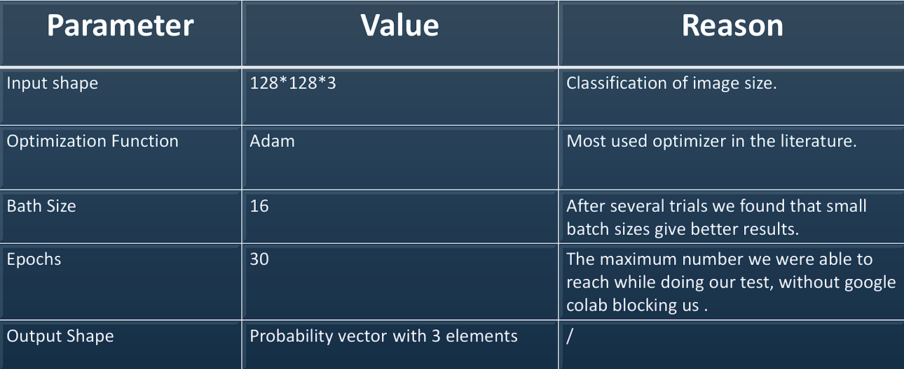
DenseNet
Dept of Computer Science & Engineering

Slide 17
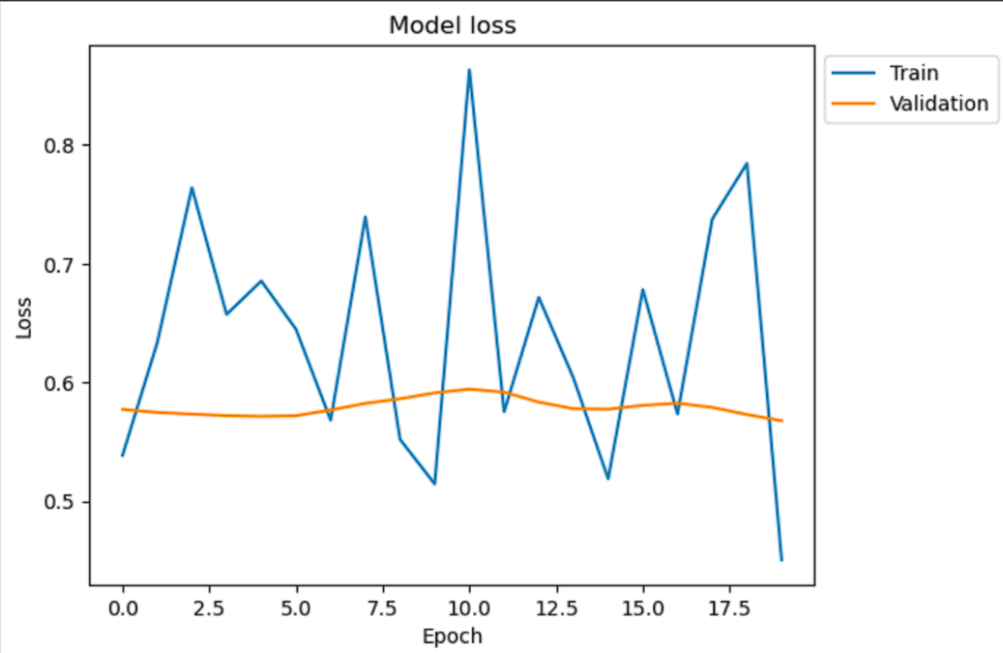
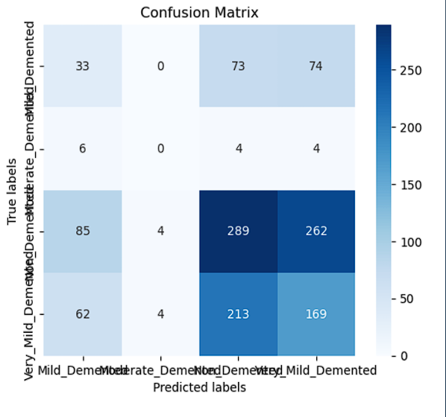
Training and Validation Loss And Confusion Matrix
Dept of Computer Science & Engineering

Slide 18
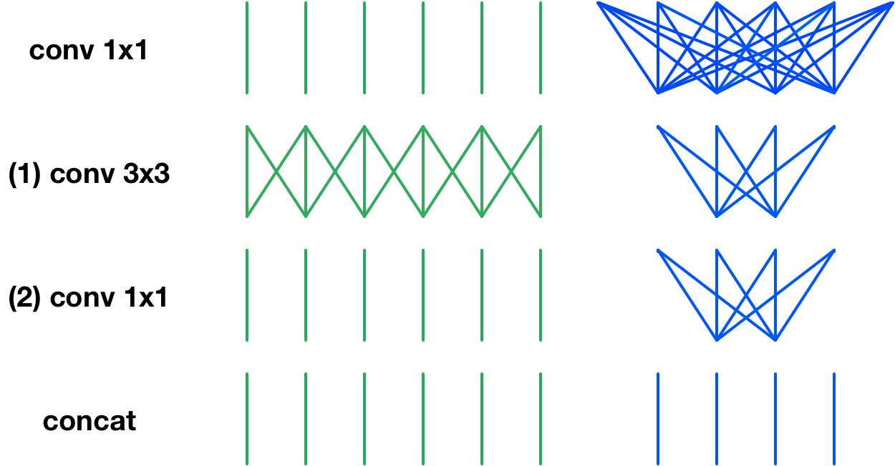
SqueezeNet
Layers: Uses "fire modules" with a "squeeze" layer (1x1 convolutions) and an "expand" layer (1x1 and 3x3 convolutions).
Design: Reduces the number of parameters while maintaining performance.
Strengths
Parameter Efficiency: Fewer parameters, leading to reduced memory usage and faster training/inference times.
Ideal for Limited Resources: Suitable for environments with limited computational resources, like mobile devices.
Challenges
Reduced Accuracy: May not capture as many fine-grained details as deeper models, potentially affecting performance in detailed medical image analysis.
ThePhoto by PhotoAuthor is licensed under CCYYSA.
Dept of Computer Science & Engineering

Slide 19
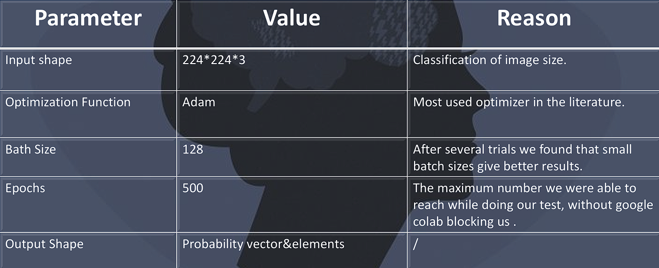
SqueezeNet
Dept of Computer Science & Engineering

Slide 20
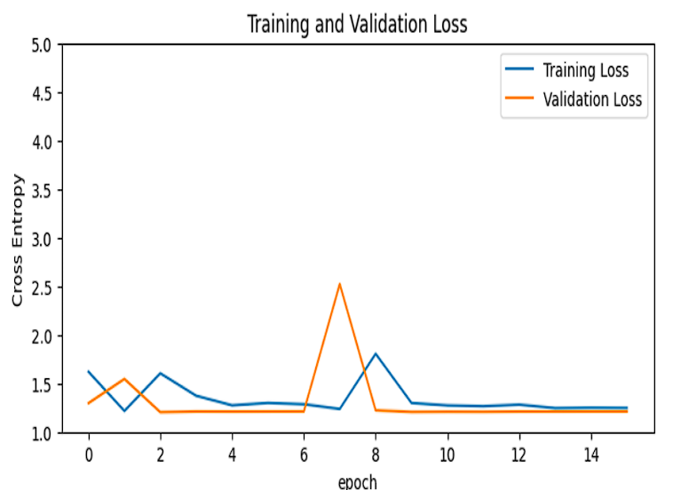
Training and validation Loss For SqueezeNet
Dept of Computer Science & Engineering

Slide 21
Results Comparision
MODEL | ACCURACY | AUC | PRECISION | RECALL
VGG19 | 0.83 | 0.96 | 0.85 | 0.80
DENSENET-121 | 0.79 | 0.95 | 0.82 | 0.79
SQUEEZENET | 47.38 | ---- | ---- | ----
Dept of Computer Science & Engineering

Slide 22
CONCLUSION
VGG19 achieved the highest accuracy at 83.2% among the models evaluated, indicating it is the most reliable for Alzheimer's Disease detection.
The architecture of VGG19, with its 19 layers, enables it to effectively capture complex and intricate features from MRI images, which is crucial for identifying subtle changes in brain structure associated with Alzheimer’s Disease.
When compared to DenseNet121 and SqueezeNet, VGG19 demonstrated superior performance metrics. DenseNet121, while also effective, showed slightly lower accuracy and performance. SqueezeNet, although efficient, did not match the performance of VGG19 in extracting detailed features.
VGG19's design provides a balance between depth and feature extraction, leading to higher accuracy in medical image analysis tasks.
Given its strong performance, VGG19 is recommended for tasks requiring detailed analysis of medical images, where high accuracy is essential.
Dept of Computer Science & Engineering

Slide 23
Thank You
Dept of Computer Science & Engineering

